Slide 1
KP Performance Test Report

Slide 2
Objective
The purpose of the testing is to assess the behaviour of the KP over an extended period of time and performing multiple dispenses daily.
Dispense accuracy (initial data collected and data after modification)
Overall performance of the KOKOPoint
Component performance (KPC, SMV, PU hose, pump, flowmeter & solenoid)

Slide 3
Performance Test Setup
Four calibrated KOKOPoints (KP-0751, KP-0567, KP-0545 and KP-0550)
20 canisters used across the four KOKOpoints
Measure the first two and last two dispenses of the day
300ml
2000ml
40 dispenses (of 2L each) per KOKOPoint per day
Time period
Start: 28th August 2019
End: 20th December 2019
Total dispensed volume in this time period - 4600L per KP
Total dispenses - 3046 per KP

Slide 4
Modification After 2020 Dispenses
All the four KPs were re-calibrated
The following changes were made to the KPs:
KP-0751 - no change made
KP-0567 - Flow meter replaced
KP-0545 and KP-0550 - Powered the flowmeter from KPC’s 12V DC using a modified BL PCB instead of the KPC’s 5V DC
Investigations to ascertain the cause of the large variation in the dispense accuracy pointed to the KP flowmeter power supply. Hence two of the KPs flowmeter were powered from the 12V DC on the KPC using a modified Below Left PCB rather than the current setup which uses the KPC’s 5V DC to power the flowmeter

Slide 5
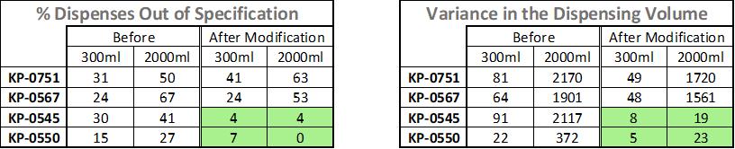
KP Dispensing Performance Conclusion
Dispense accuracy improved on the KPs installed with the modified Below Left PCB (KP-0550 and KP-0545)
Tank level and flow rate have no effect on the accuracy of a dispense on the KPs with modified BL PCBs (KP-0545 and KP-0550)
Tank level has an effect on the accuracy of a dispense (KP-0567 and KP-0751) - the two KPs were unmodified throughout the test

Slide 6

KP Dispensing Accuracy

Slide 7
KP Component(s) Performance
Component | Failure | KP | Failure mode | Comments
Pump | Yes | KP-0545 KP-0550 | Flow rate drops as dispense progresses triggering E092 at about 1.3L-1.4L. Following the Error 092 troubleshooting flowchart led to replacing the pump. | Upon replacement, flow rates improved (FRL 1.3L/min) Pumps tested on bench; KP-0545 pump avg 1.18L/min vs 1.49L/min during QC, (1.2-1.46 on KP) KP-0550 pump avg 1.27L/min vs 1.21L/min during QC.
Smart valve | Yes | KP-0545, KP-0550, KP-0567, KP-0751 | KP-0571, KP-0567 SMV passing fuel into the dispense airline. KP-0550 SMV flooding after a dispense | KP-0751 First SMV started flooding after 168 dispenses in KP-0751. Second cases came up after 2600 dispenses on the other 3 KPs (545,567,550)
KPC | Yes | KP-0751 | Persistent ‘Controller Temp out of spec’ Error
Flowmeter | None | N/A | N/A | N/A
Solenoid valve | None | N/A | N/A | N/A
PU hose | None | N/A | N/A | N/A

Slide 8
Errors Observed
Error | Identified root cause | Resolved by | Comments
Flow rate out of spec (Error 092) | Smart Valve passing fuel into airline during dispense Pumping rate decreases with time. Smart valve flooding (on one KP when specific canisters are used) | Changed the SMV Changed pump | Canisters observed to flood SMV on one KP did not cause flooding in any other KP. Error started occurring after 2600 dispenses on the 3 KPs
Ethanol vapour levels high (E067) | Ethanol fumes accumulation during KP refill | Ensuring proper ventilation during KP refill | E067 during dispenses caused ‘freezing’ of the KP screen PVRV weren’t installed in these 4 KPs
Controller temperature out of spec | Investigations pointed to a heating inductor though no immediate conclusion on specific cause for the heating | Replaced KPC | Error was persistently experienced in one KP when two successive 2L dispenses are done.

Slide 9
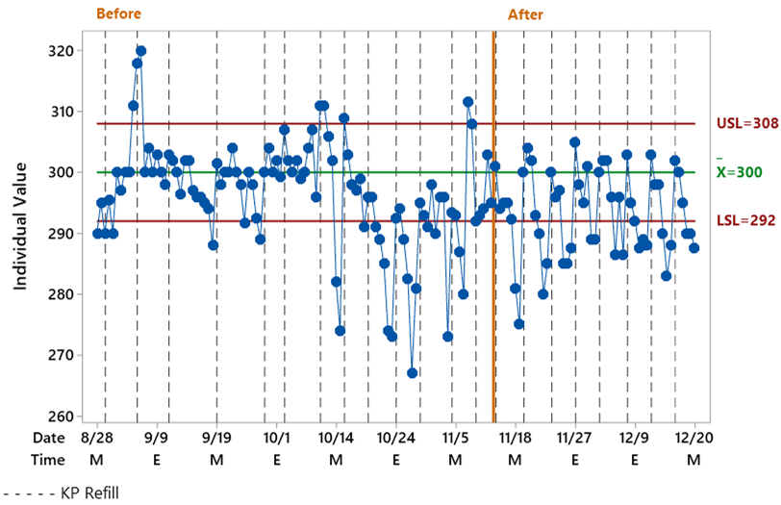
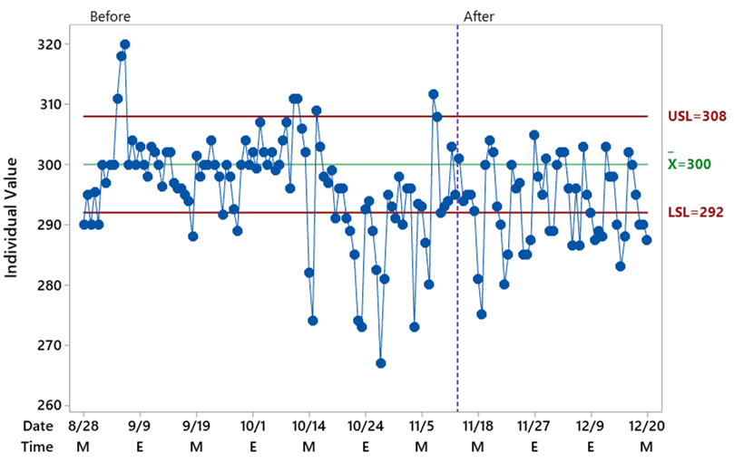
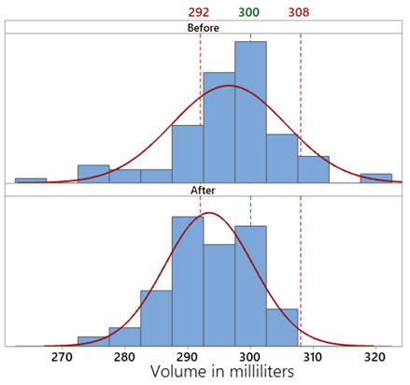
KP-0751: 300ml Dispenses
Summary
KP was re-calibrated after the 2020th dispense
After recalibration the mean was significant lower and the standard deviation was not reduced
Out of specification dispensed volume increased by 37%

Slide 10
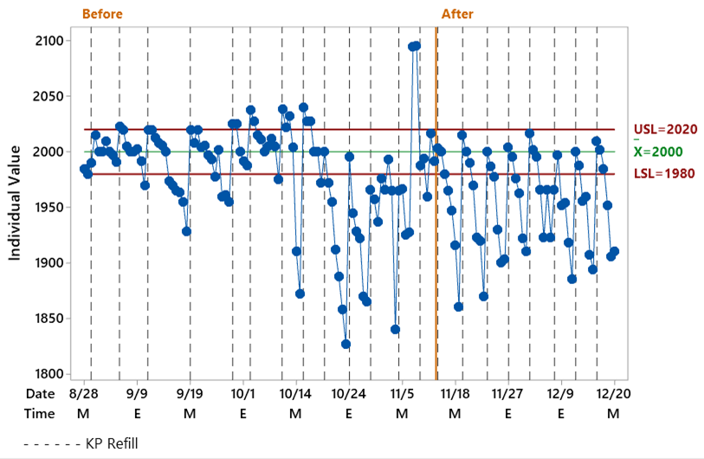
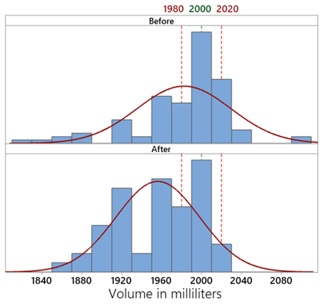
KP-0751: 2000ml Dispenses
Summary
KP was re-calibrated after the 2020th dispense
After recalibration the mean was significant lower and the standard deviation was not reduced
Out of specification dispensed volume increased by 23%

Slide 11
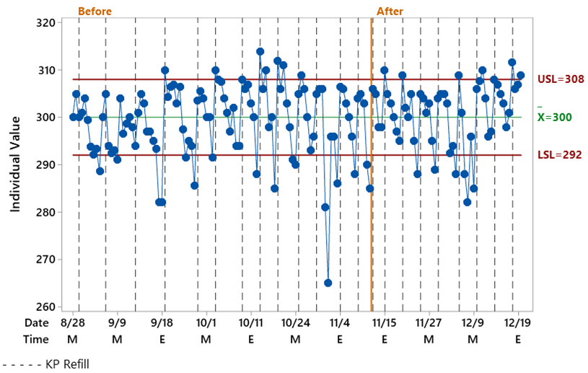
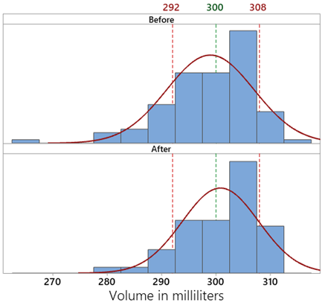
KP-0567: 300ml Dispenses
Summary
Replaced flow meter and re-calibrated the KP
No change on the mean of the volume dispensed and the standard deviation was not reduced
Out of specification dispensed volume was reduced by 1%

Slide 12
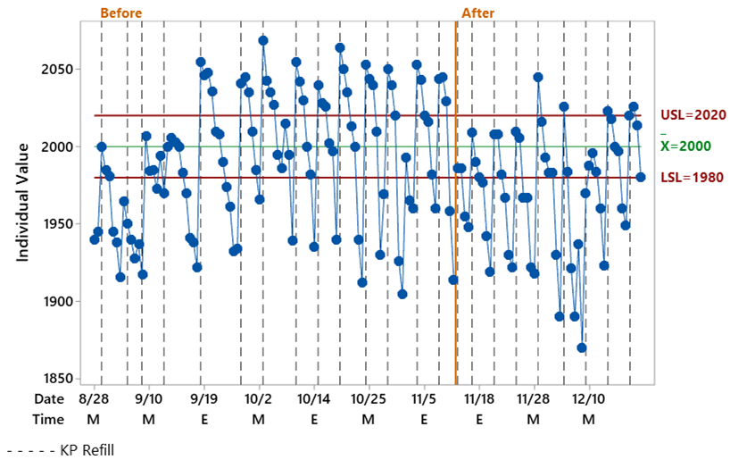
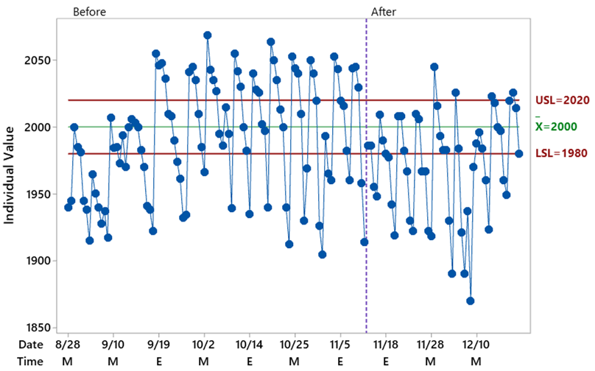
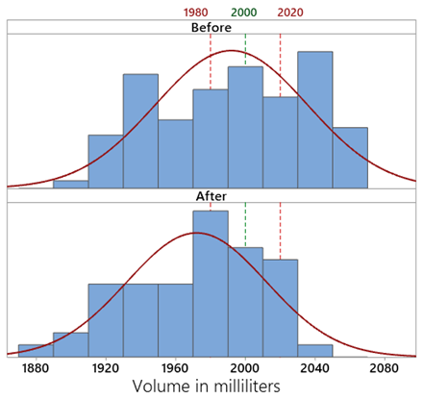
KP-0567: 2000ml Dispenses
Summary
Slightly lower mean of the volume dispensed and the standard deviation was not reduced
Out of specification dispensed volume was reduced by 21%

Slide 13
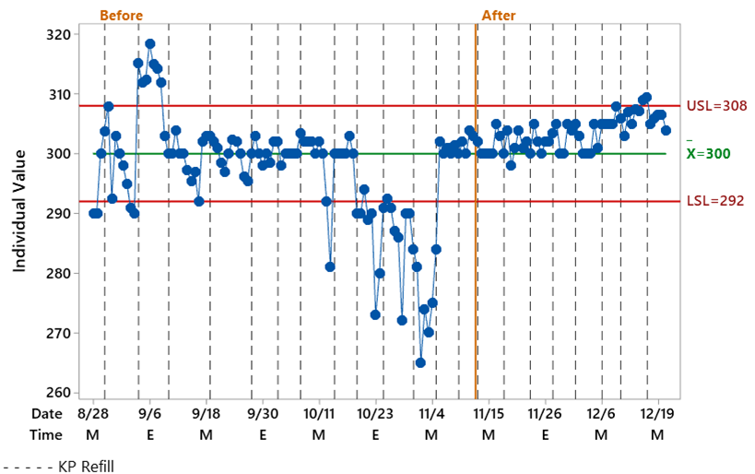
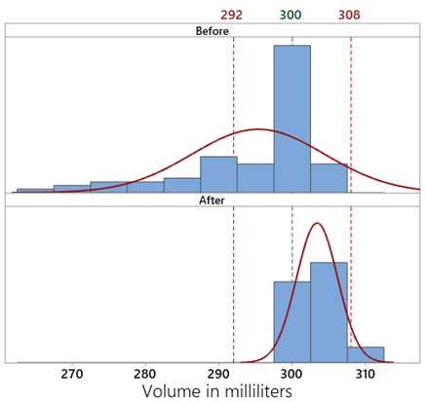
KP-0545: 300ml Dispenses
Summary
Installed a modified BL PCB and re-calibrated the KP
The mean is closer to the target of 300ml and the standard deviation was significantly reduced
Out of specification dispensed volume was reduced by 85%

Slide 14
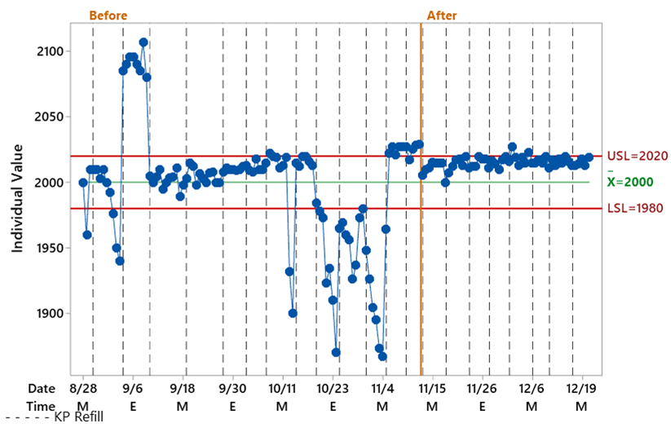
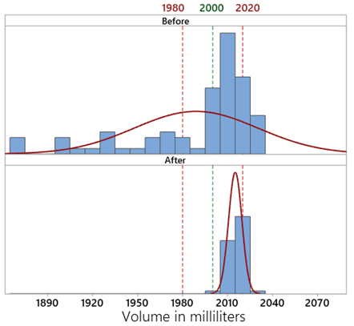
KP-0545: 2000ml Dispenses
Summary
The mean is slightly greater than the target of 2000ml and the standard deviation was significantly reduced
Out of specification dispensed volume was reduced by 90%

Slide 15
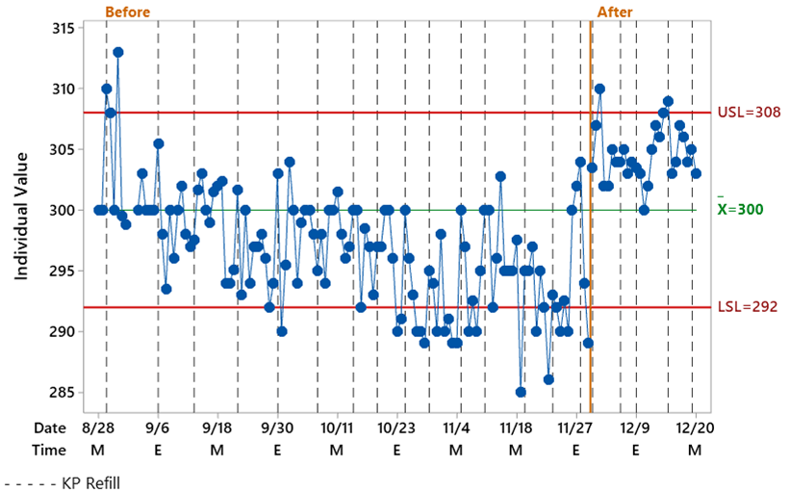
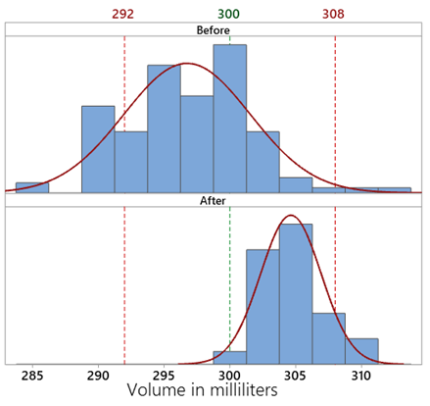
KP-0550: 300ml Dispenses
Summary
Installed a modified BL PCB and re-calibrated the KP
The mean is significantly higher and the standard deviation was significantly reduced
Out of specification dispensed volume was reduced by 57%

Slide 16
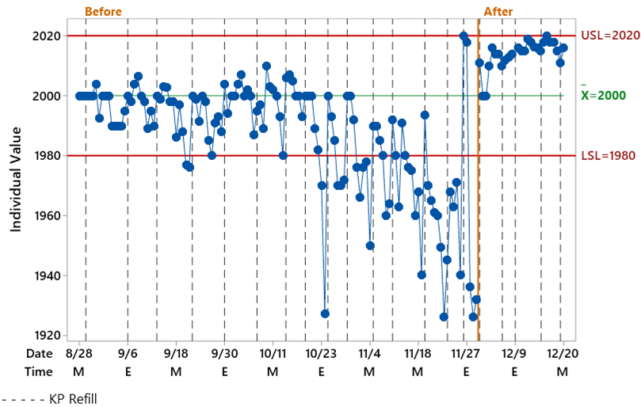
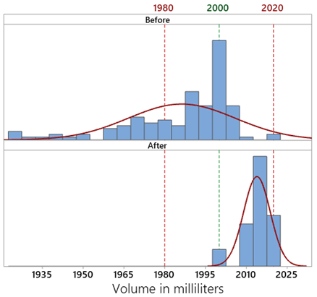
KP-0550: 2000ml Dispenses
Summary
The mean is significantly higher and the standard deviation was significantly reduced
All the dispensed volume were within specification

